Slide 1


CareerVault: Five Security Points, Addressed
Aaryan Sharma · Aditya Baheti · Anamay Narkar · Anuj Madke
LY Project Evaluation · K J Somaiya School of Engineering
Notes:
Good morning. The last review gave us five security points. Today we show what we changed for each one, where we did it differently and why, and then we demo it live.

Slide 2
The five points, and what we did
1
Personal employee keys
DONE
2
No proof files
DONE
3
Own bytes + SHA-256
DONE
Was: One organisation key signed everything.
Now: Each manager and HR has a key made from their DOB, ID and 3 answers. AES → HMAC-SHA256 → RSA-2048. Re-entered at every signature.
Was: A downloadable .jsonld handed out the salt, keys and algorithms.
Now: Verify by Document ID only. The server checks everything and returns a verdict with nothing cryptographic.
Was: A third-party JSON canonicalisation library.
Now: Our own fixed byte format, and SHA-256 written bit by bit in our own code, shown live.
4
Blockchain is optional
DONE
5
Input hardening
DONE
458
Was: A missing anchor made the verdict INVALID.
Now: The verdict never depends on the chain. The anchor is a small badge.
Was: Validation per form only.
Now: Every request screened for tampering, strict ID formats, parameterised SQL, errors that leak nothing.
automated tests pass
389 server · 38 API end-to-end (14 of them attacks) · 23 browser · 8 SHA-256
Notes:
Five cards, one per point, each live on the app now. The sixth card is the test count: every change is covered by automated tests, including attack tests. The next slides take each point in turn.

Slide 3
One document, through the new pipeline
Enrol once
Lock K
Step-up
Hash + seal
Sign + store
DOB + personal ID + 3 answers → PBKDF2-SHA256, 600,000 rounds → 256-bit key K
AES-256-GCM under the organisation key. Only ciphertext is stored, never the answers
Re-enter the details → re-derive → constant-time match → K unlocked for one signature
Exact bytes B → SHA-256(B) = hash. HMAC-SHA256(K, B) = personal seal
RSA-2048 signs (hash, seal, role, member, key id). Everything AES-encrypted in the DB
Manager: stages 3–5 at signing. HR: stages 3–5 again at approval, with their own key, after re-checking the hash.
AES → SHA-256 (HMAC) → RSA-2048: three layers, two people, and one record that cannot change without every check failing.
Notes:
Read left to right. A signer enrols once. Their key is locked with AES and stored. At every signature they re-enter their details, which unlocks the key. The document becomes exact bytes; SHA-256 gives the hash, HMAC with the personal key gives the seal, and RSA-2048 signs both. The manager does this at signing, HR does it again with their own key at approval.

Slide 4
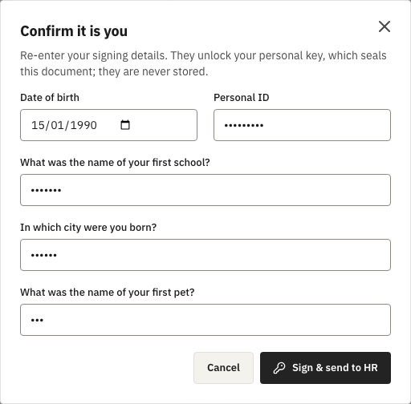
Point 1 · Each signer has their own key
1
Enrol once
Date of birth, a personal ID and three security answers, normalised (case and spaces ignored) and length-prefixed.
2
Stretch
PBKDF2-SHA256, 600,000 rounds, random 16-byte salt → a 256-bit key.
3
Lock
AES-256-GCM under the organisation’s key. Only this locked key is stored, never the answers.
4
Unlock to sign
Every signature asks again. A wrong answer is refused; 5 in 15 minutes lock signing.
The step-up before every signature (answers masked)
Notes:
Four steps. Enrol once with date of birth, a personal ID and three answers we normalise, so capital letters and extra spaces do not matter. PBKDF2 stretches them 600,000 times with a random salt. AES-256-GCM locks the result; the answers are never stored. At every signature the signer re-enters them; the screenshot is that dialog. Five wrong tries lock signing for 15 minutes.

Slide 5
Point 1 · Why the AES output is not the HMAC key
As suggested
What we built
• HMAC key = the AES ciphertext
• AES-GCM output changes every time (random IV), so it must be stored
• Stored means: whoever can read the database has the HMAC key
• The AES layer then protects nothing
• AES-256-GCM locks the key at rest
• The server unlocks it in memory, for one signature only
• HMAC-SHA256 uses the real, unlocked key
• Forging a seal needs the server’s key AND the employee’s answers
Also honest: date of birth and ID are not secrets (HR knows them). The random salt, 600,000 PBKDF2 rounds and the server lock give the strength; the answers add a check only the employee can pass, so a stolen login cannot sign.
Notes:
The suggestion was to use the AES-encrypted key itself as the HMAC key. AES-GCM uses a fresh random IV, so the ciphertext changes every time and would have to be stored. Then anyone who can read the database holds the HMAC key, and the AES layer protects nothing. So AES locks the key at rest, the server unlocks it in memory for one signature, and HMAC uses the real key. The bottom note is honest about the answers: DOB and ID are not secrets, so the strength comes from the salt, PBKDF2 and the server lock.

Slide 6
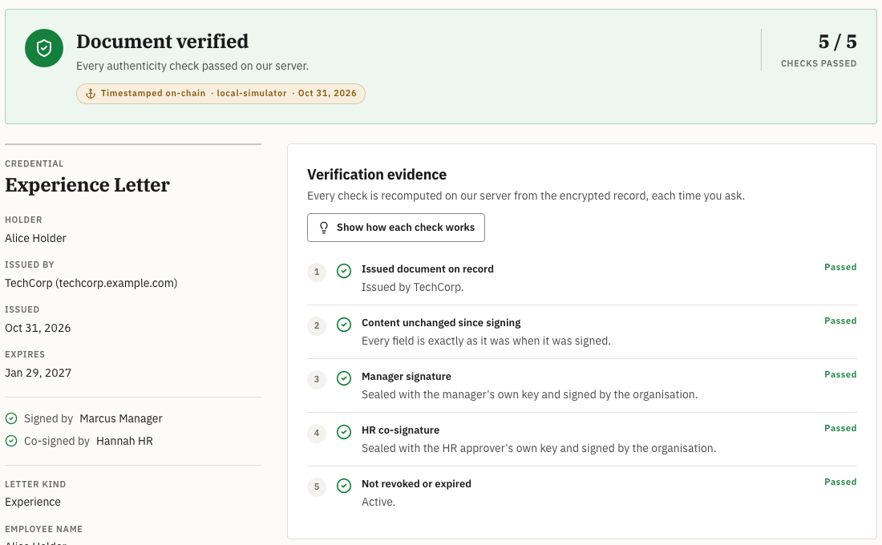
Point 2 · Verification happens only on our server
Verifier sends only the Document ID (or a share link)
1
Server decrypts the record and rebuilds the exact bytes
2
Recomputes the hash, both personal seals, both RSA signatures and revocation
3
Returns verdict, issuer and signers, nothing cryptographic
4
Tested: the response never contains a salt, hash, seal, signature, key, Merkle root or algorithm name
Notes:
The verifier sends only the document ID or a share link. Our server decrypts the record, rebuilds the exact bytes, and recomputes the hash, both personal seals, both RSA signatures and revocation. It returns the result, the issuer and who signed, and nothing cryptographic. A test fails if a salt, hash, seal, key, root or algorithm name ever appears in the response.

Slide 7
Point 2 · Why we removed the downloadable proof file
October: proof file (.jsonld)
Now: verified on our server
• Anyone could verify it offline
• But it handed out the salt, public key, both signatures and every algorithm
• Personal keys never leave the server, so an offline check is impossible by design
• The verifier learns the result, not how to recompute it
Trade-off we accept: if CareerVault is down, verification waits. The PDF still carries its Document ID and the chain keeps its timestamp.
To be precise: hiding algorithm names is not what protects us (Kerckhoffs’s principle). Keeping salts and keys secret is.
Notes:
Last time our answer was an offline proof file. It worked without us, but it handed every verifier the salt, the public key, both signatures and every algorithm. With personal keys held on the server, an offline check is impossible by design, so we chose issuer-run verification. The trade-off: if our server is down, verification waits. And to be precise: hiding algorithm names is not what keeps us safe; keeping salts and keys secret is.

Slide 8
Point 3 · Our own byte format, no JSON library
CVDOC
v2
len · document ID
len · type
len · organisation
len · holder
fields: tag · len · value
salt · 32 bytes
Every value is tag ‖ length ‖ value: string 0x01 · integer 0x02 · boolean 0x03 · list 0x04 · object 0x05
Length-prefixed
Strict types
Bound to the person
{a: "ab", b: "c"} and {a: "a", b: "bc"} give different bytes, so nothing can slide between fields.
Integers only (salary in paise). Floats and nulls are refused. Object keys in byte order.
Document ID, organisation and holder are inside the bytes: moving a record to someone else breaks it.
Pinned test: {name: "Jane", years: 3} → 225 bytes → SHA-256 = 9dc984c0d8af5754…
Notes:
Instead of a canonicalisation library we write the document as exact bytes ourselves: a magic word, a version, then each field as tag, length, value, then the 32-byte salt. Three rules make it safe: length prefixes so shifting a character between fields changes the bytes, strict types, and the document, organisation and holder IDs inside the bytes, so moving a record to someone else breaks it. The example at the bottom is a pinned test.

Slide 9
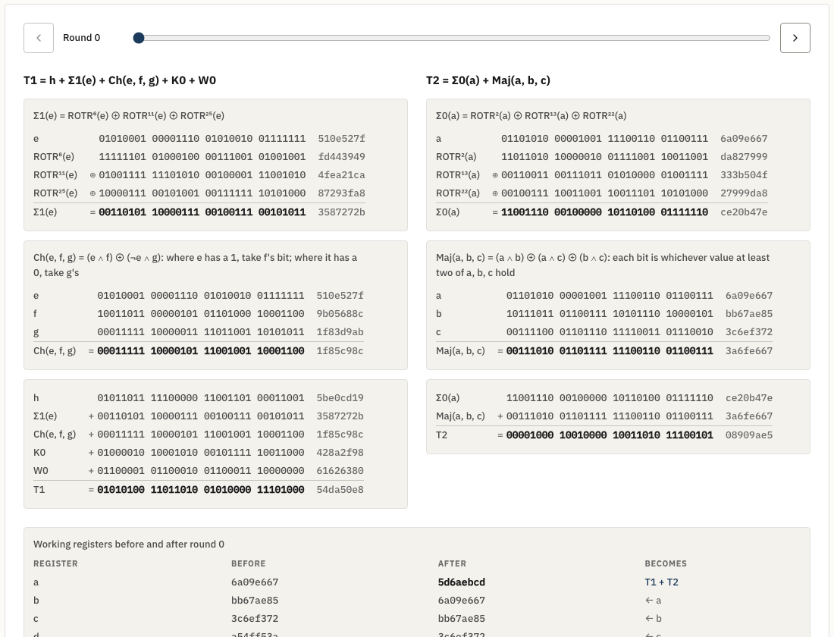
Point 3 · SHA-256, bit by bit, in our own code
1
Padding
Message → bits → one 1 bit → zeros → 64-bit length = 512 bits
2
Schedule
16 words grow to 64 using σ0 and σ1: rotate, shift, XOR
3
64 rounds
Σ0, Σ1, Ch and Maj build T1 and T2; registers shift
4
Digest
Checked live against the browser’s SHA-256; NIST test vectors pass
Live: /demo/sha256 → type “abc”
Notes:
We wrote SHA-256 ourselves, with no library, and built a page that traces it. Type “abc”: it shows the padding to 512 bits, the 16 words growing to 64, and each of the 64 rounds at bit level. The final digest is checked live against the browser’s own SHA-256 and against the NIST test values. Production still uses the standard library; this is our proof that we understand what it does.

Slide 10

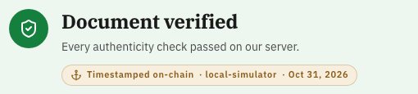
Point 4 · Blockchain is a badge, not a gate
Encrypted storage (AES-256-GCM)
Before the batch: pending
VERIFIED
Tamper-proof pipeline (AES → SHA-256 → RSA-2048)
After “Anchor now”: timestamped (live site links PolygonScan)
Server-side verification
Chain unreachable or a root missing → still VERIFIED; the badge reads “unreachable” or “not confirmed”. The system works as a complete product without a blockchain; Polygon adds a public, independent timestamp.
Notes:
The verdict comes only from our three pillars: encrypted storage, the AES, SHA-256 and RSA pipeline, and server-side checks. The chain is a public timestamp shown as a badge. Before the nightly batch it says pending; after, it links the Polygon transaction. If the chain is unreachable the document is still verified and the badge says so. All three cases are tested.

Slide 11
Point 5 · Attacks we ran against our own API
Attack | What we sent | Result
SQL injection (login) | ' OR 1=1 -- as the email | Refused: not an email (400)
SQL injection (stored) | Robert'); DROP TABLE users;-- as a name | Stored as plain text; table intact (parameterised queries)
Prototype pollution | "__proto__": {"isAdmin": true} | Refused: reserved key (400)
Script injection | <script>alert(1)</script> as a name | Refused: markup (400)
Malformed ID | 1' OR '1'='1 as a document ID | Refused: not a UUID (400)
Error leaks | A duplicate or missing record | Generic 409 / 404: no table or column names
All 14 run automatically on every change: server/test/adversarial.e2e-spec.ts
Notes:
Every row is an automated test against the real server and database. The second row matters most: we do not block SQL words, we store them safely. Every query is parameterised, so the classic DROP TABLE text is just a strange name, and the users table is still there. Everything else is refused at the door, and error messages never name a table or column.

Slide 12
Where we did it differently, and why
Suggestion | What we did, and why
Use the AES ciphertext as the HMAC key | AES locks the key; HMAC uses the unlocked key. Otherwise the database alone could forge seals.
Strip SQL keywords from input | Parameterised queries + strict ID formats. Blocklists break real names (O’Brien) and are easy to bypass.
Zod on every API endpoint | The API already validates every field with class-validator. Zod stays on the client forms; two validators would drift.
Hide algorithms and public keys | Removed from the verify page, but security never relies on it (Kerckhoffs). Salts and keys stay secret.
Keep the offline proof as well | Impossible with personal keys held on the server; the Document ID and chain timestamp remain.
Notes:
Five places where we did not follow the suggestion literally, each for a security reason. We would rather say this up front: in each case, the literal version would have been weaker or would have broken real input.

Slide 13
Summary: all five points are live
POINT
STATUS
SHOW IT LIVE
1
Personal employee keys
Profile → Signing security; sign → step-up dialog
DONE
2
Server-only verification
Document → Open public verification
DONE
3
Own bytes + SHA-256 lab
Demo guide → SHA-256 lab → “abc”
DONE
4
Blockchain is a badge
Verify, then “Anchor now”, then verify again
DONE
5
Input hardening
A <script> name or a bad ID → refused
DONE
Notes:
Each point is live on the deployed site. The right column is where we will click during the demo.

